Slide 1
U.S. Bank Market Analysis
By: Suyash Gupta , Skye Liu , Alexis Hu, and Chase Blackmun

Slide 2
Our Story
Goal:
Examine the US bank market
Analyze the performance of top 1 player
Approach:
Narrowed our bank data from 4,356 different banks, to the top 10
Analysis on Deposits, Branches and Market Share
Now it's time to take a deep dive…
Who is the top 1 player?
Does JPM Chase have the highest number of deposits because they have the highest number of branches?
Which region is the best performing one for top 1 player?

Slide 3
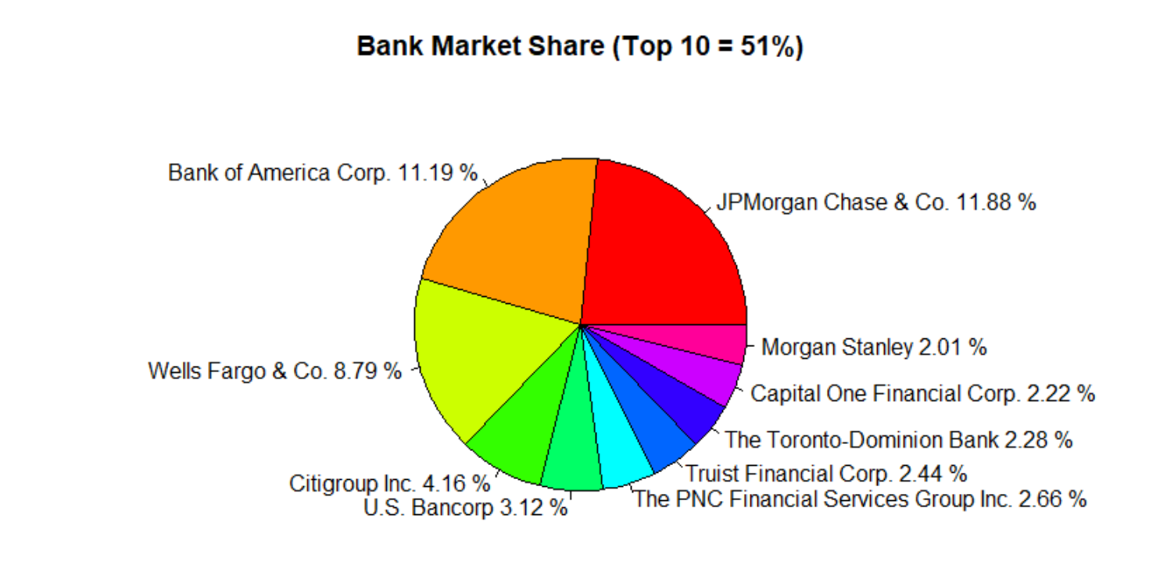

Market Share
Top 10 banks have captured over 50% of market share, and JP Morgan Chase has the highest number of deposits in the U.S.

Slide 4
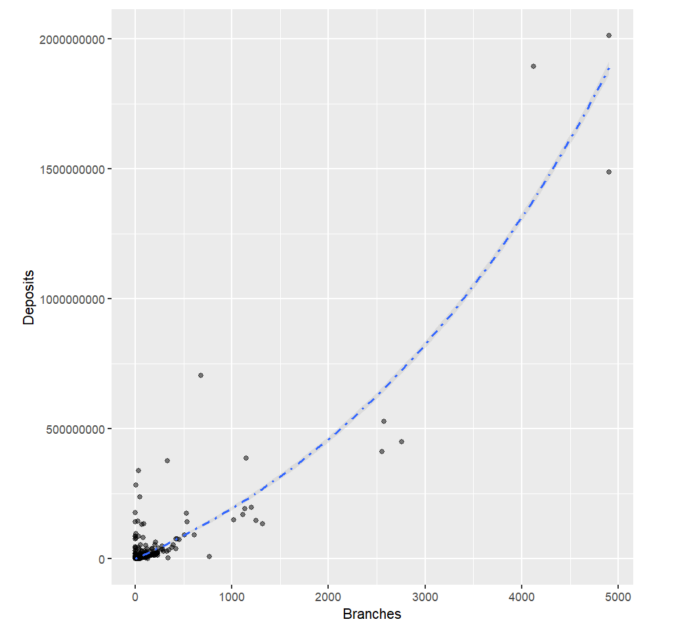
Branches↑，Deposit ↑
Bank deposit has an exponential relationship with the number of branches
As the number of branches goes up, one can expect that the number of deposits grows exponentially.

Slide 5
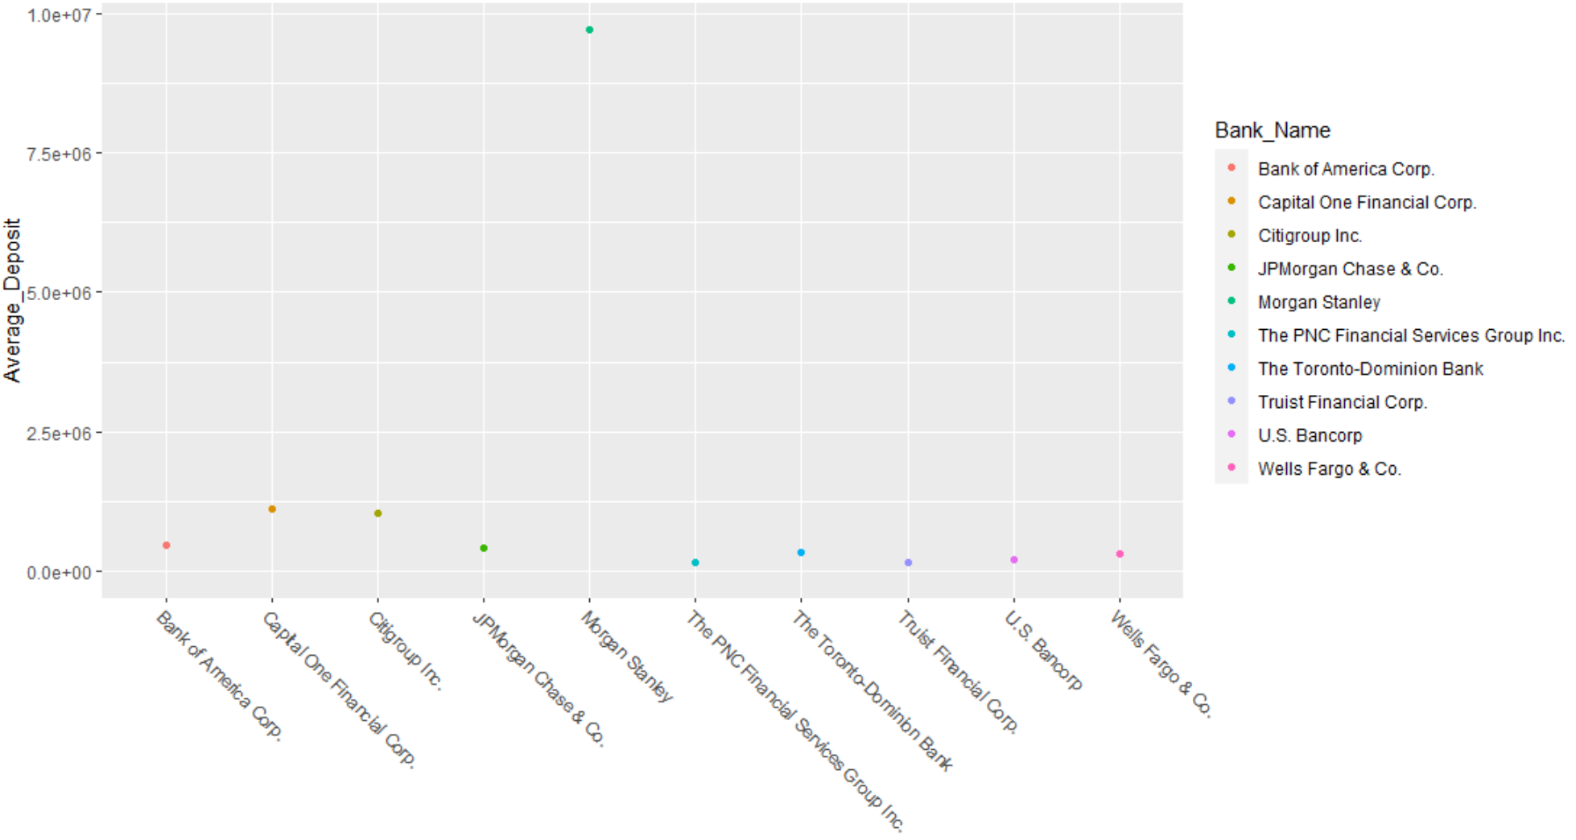
Average Deposits Per Branch

Slide 6
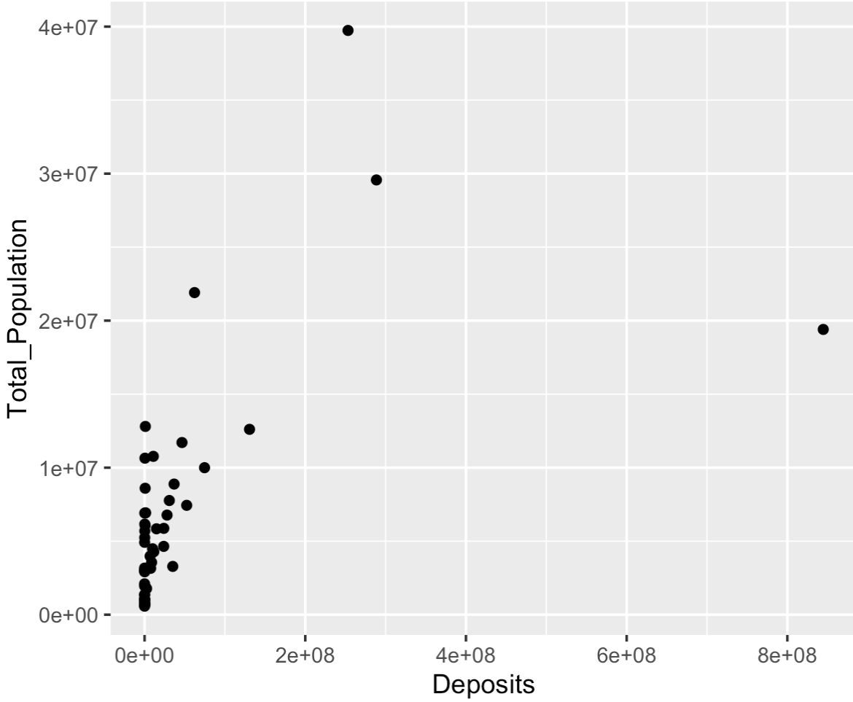
Population has no significant effect on the bank deposit

Slide 7
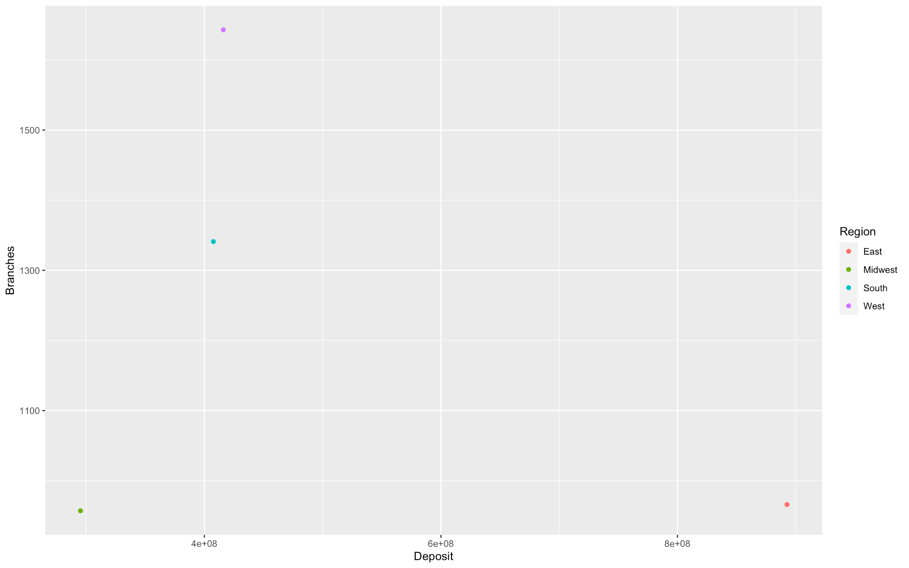
Best Performing Regions for JP Morgan: East and South

Slide 8
Conclusion:
JPM Chase has established themselves as the number one player in banking.
JPM Chase’s success stems from their excellent performance in the East region.
With more time, we would love to analyze the growth and success of JPM Chase over the last 30 years and discover how JPM has become the number one bank in the United States.

